Slide 1
Pharmacokinetics/ Pharmacodynamics What’s the difference?
Concentration
Effect
Time
Concentration
PK: Concentration
ADME
PD: Effect

Slide 2
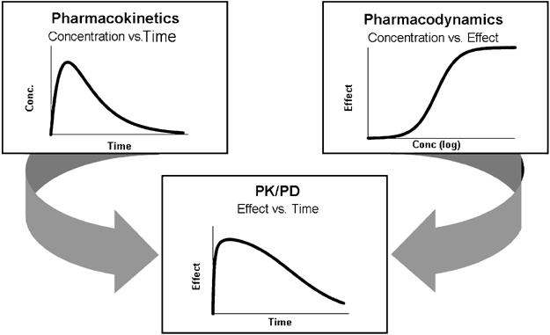
PK/PD
www.nature.com

Slide 3
AUC oral
AUC IV
F (Bioavailability) =
Drug systemic = Dose * S (% API) * F (% in blood)
Ex:
Dose = 100 mg
S = 50% API (50% Phenytoin, 50% Na)
F = 50% in blood
Drug systemic = 100 mg * 0.5 * 0.5 = 25 mg in blood
Dose (mg)
C0 (mg/L in blood plasma)
Vd (mg) =
Vd * (C desired – C current)
S*F
Loading Dose (LD) =

Slide 4
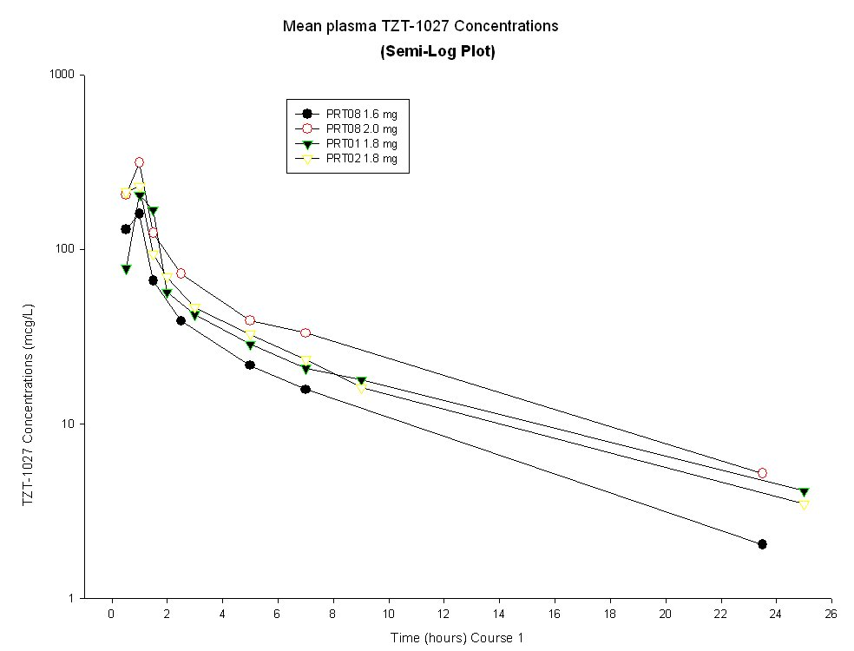
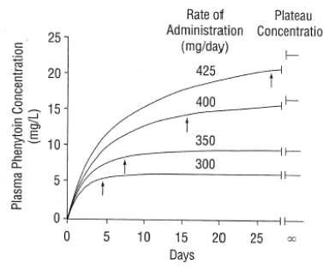
First-order elimination kinetics :
C = Cmax * e^{-ke(t)}
y2 – y1
X2 – x1
Find slope (rate of elim) =
Ln (C1 / C2)
t2 - t1
Ke =
Michaelis-Menten PK:
Vmax * C
Km + C
Rate of Metabolism =

